Slide 1
CS492 - Operating Systems Virtual Memory
Georgios Portokalidis & Jun Xu
ZyBook 7, MOS 3.3-3.7
Slides credit: Antonio Barbalace

Slide 2
Virtual Memory
A powerful concept for the address-space abstraction
Does not suffer from the shortcomings of previous approaches (covered in memory management)
Method devised by Fotheringham in 1961
Decouples address space from physical memory
Illusion of large and private address space
Address space can be larger than physical memory
Programs can execute even if partially loaded in memory
Frequently enables different memory protection policies
Notes:
The method that was devised (Fotheringham, 1961) has come to be known as virtual memory.
https://www.tutorialspoint.com/operating_system/os_virtual_memory.htm
The main visible advantage of this scheme is that programs can be larger than physical memory. Virtual memory serves two purposes.
First, it allows us to extend the use of physical memory by using disk.
Second, it allows us to have memory protection, because each virtual address is translated to a physical address.
when entire program is not required to be loaded fully in main memory
User written error handling routines are used only when an error occurred in the data or computation.
Certain options and features of a program may be used rarely.
Many tables are assigned a fixed amount of address space even though only a small amount of the table is actually used.
The ability to execute a program that is only partially in memory would counter many benefits
Less number of I/O would be needed to load or swap each user program into memory.
A program would no longer be constrained by the amount of physical memory that is available.
Each user program could take less physical memory, more programs could be run the same time, with a corresponding increase in CPU utilization and throughput.
As a consequence of these developments, there is a need to run programs that
are too large to fit in memory, and there is certainly a need to have systems that can
support multiple programs running simultaneously, each of which fits in memory
but all of which collectively exceed memory. Swapping is not an attractive option,
since a typical SATA disk has a peak transfer rate of several hundreds of MB/sec,
which means it takes seconds to swap out a 1-GB program and the same to swap in
a 1-GB program

Slide 3

Virtual Memory: Method
MAX
Each process its own (virtual) address space
From address 0x00, to MAX
Program operates on virtual addresses
Virtual address ≠ physical RAM address
Virtual address translated to physical address
Translation transparent to the program
Stack
Virtual Address
Heap
bss
data
text
0x00
Virtual Memory
f(x)
RAM
size
Physical
Address
0x00
Physical Memory
Notes:
Virtual memory works just fine in a multiprogramming system, with bits and pieces of many programs in memory at once. While a program is waiting for pieces of itself to be read in, the CPU can be given to another process.
From Fotheringham, 1961, a block of information occupies either a page of core store (RAM) or a sector of drum store (disk). The programmer doesn’t need to think of addresses in this way, but this is how they are treated by the machine
In a sense, virtual memory is a generalization of the base-and-limit-register idea. The 8088 had separate base registers (but no limit registers) for text and data. With virtual memory, instead of having separate relocation for just the text and data segments, the entire address space can be mapped onto physical memory in fairly small units. We will show how virtual memory is implemented below.

Slide 4
Virtual Memory: Method
What is MAX?
MAX
Each process its own (virtual) address space
From address 0x00, to MAX
Program operates on virtual addresses
Virtual address ≠ physical RAM address
Virtual address translated to physical address
Translation transparent to the program
Stack
Virtual Address
Heap
(Theoretically) Max addressable data by processor
bss
data
text
0x00
Virtual Memory
f(x)
RAM
size
Physical
Address
0x00
Physical Memory
Notes:
Virtual memory works just fine in a multiprogramming system, with bits and pieces of many programs in memory at once. While a program is waiting for pieces of itself to be read in, the CPU can be given to another process.
From Fotheringham, 1961, a block of information occupies either a page of core store (RAM) or a sector of drum store (disk). The programmer doesn’t need to think of addresses in this way, but this is how they are treated by the machine
In a sense, virtual memory is a generalization of the base-and-limit-register idea. The 8088 had separate base registers (but no limit registers) for text and data. With virtual memory, instead of having separate relocation for just the text and data segments, the entire address space can be mapped onto physical memory in fairly small units. We will show how virtual memory is implemented below.

Slide 5
Virtual Memory: Method (Continue)
Virtual address space broken into chunks
Chunk is a contiguous range of addresses
Mapped onto a contiguous range of physical memory
Process always sees the entire virtual address space
MAX
Stack
Heap
RAM
size
0x2000
Chunk
bss
0x124000
0x1000
bss
data
0x123000
text
0x00
Virtual Memory
Physical Memory
0x00
Notes:
Virtual memory works just fine in a multiprogramming system, with bits and pieces of many programs in memory at once. While a program is waiting for pieces of itself to be read in, the CPU can be given to another process.
From Fotheringham, 1961, a block of information occupies either a page of core store (RAM) or a sector of drum store (disk). The programmer doesn’t need to think of addresses in this way, but this is how they are treated by the machine
In a sense, virtual memory is a generalization of the base-and-limit-register idea. The 8088 had separate base registers (but no limit registers) for text and data. With virtual memory, instead of having separate relocation for just the text and data segments, the entire address space can be mapped onto physical memory in fairly small units. We will show how virtual memory is implemented below.

Slide 6
Virtual Memory: Method (Continue)
Virtual address space broken into chunks
Chunk is a contiguous range of addresses
Mapped onto a contiguous range of physical memory
Process always sees the entire virtual address space
Not all chunks need be in physical memory to run the program
Chunk switching hidden from processes
Program references a chunk loaded in physical memory → Hardware performs the necessary mapping on the fly
Program references a chunk not in physical memory → OS gets it from disk and re-executes the memory instruction
Notes:
Virtual memory works just fine in a multiprogramming system, with bits and pieces of many programs in memory at once. While a program is waiting for pieces of itself to be read in, the CPU can be given to another process.
From Fotheringham, 1961, a block of information occupies either a page of core store (RAM) or a sector of drum store (disk). The programmer doesn’t need to think of addresses in this way, but this is how they are treated by the machine
In a sense, virtual memory is a generalization of the base-and-limit-register idea. The 8088 had separate base registers (but no limit registers) for text and data. With virtual memory, instead of having separate relocation for just the text and data segments, the entire address space can be mapped onto physical memory in fairly small units. We will show how virtual memory is implemented below.

Slide 7
Virtual Memory: Techniques
Paging
One dimensional address space
Segmentation
Multi dimensional address space

Slide 8
Paging (1)
Virtual address space consists of fixed-size units called pages
Corresponding units in physical memory are called page frames
Pages and page frames are of the same size
Usually 4kB
Page sizes from 512B to 1GB have been used
Example
4kB page size with 64kB of virtual address space and 32kB of physical memory, gets 16 virtual pages and 8 page frames
The hardware memory management unit (MMU) maps pages to page frames

Slide 9
Paging (2)
Application view → single, private, contiguous address space
Ranging from 0x00 to 2^{P}– 1 bytes
P is <= the number of bits in a pointer (e.g., 64 bits)
Reality → Application code and data are scattered across physical memory
The mapping between pages and page frames
Invisible to the program
Controlled by the OS via MMU
Not all pages are loaded in physical memory

Slide 10
Paging: Single Process
Virtual
Address Space
Physical
Address Space
Total RAM
0xFFFF…
(2^{P}-1)
Stack
Heap
MMU
Unitilized Variables (bss segment)
Initialized Variables
(data segment)
Code
(text segment)
0x00
0x00
Virtual Memory
(Pages)
Physical Memory
(Page frames)

Slide 11
Paging: Many Processes
Stack
Heap
Stack
Unitilized Variables (bss segment)
Initialized Variables
(data segment)
Heap
Code
(text segment)
Unitilized Variables (bss segment)
MMU
Initialized Variables
(data segment)
Stack
Code
(text segment)
Heap
Unitilized Variables (bss segment)
Initialized Variables
(data segment)
Code
(text segment)
Physical Memory
(Page frames)
Virtual address spaces

Slide 12
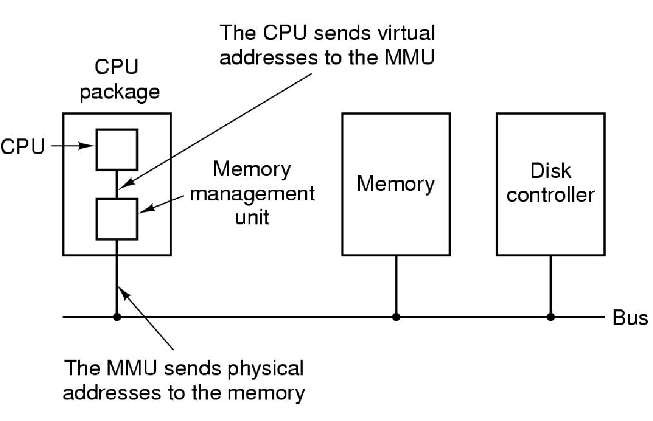
Paging: Hardware
CPU sends virtual addresses to the MMU
MMU
MMU sends physical addresses to the memory
The position and function of the MMU – shown as being a part of the CPU chip. (MOS Figure 3-8.)
Notes:
On computers without virtual memory, the virtual address is put directly onto the memory bus and causes the physical memory word with the
same address to be read or written. When virtual memory is used, the virtual addresses
do not go directly to the memory bus. Instead, they go to an MMU (Memory
Management Unit) that maps the virtual addresses onto the physical memory
addresses, as illustrated in Fig. 3-8.

Slide 13
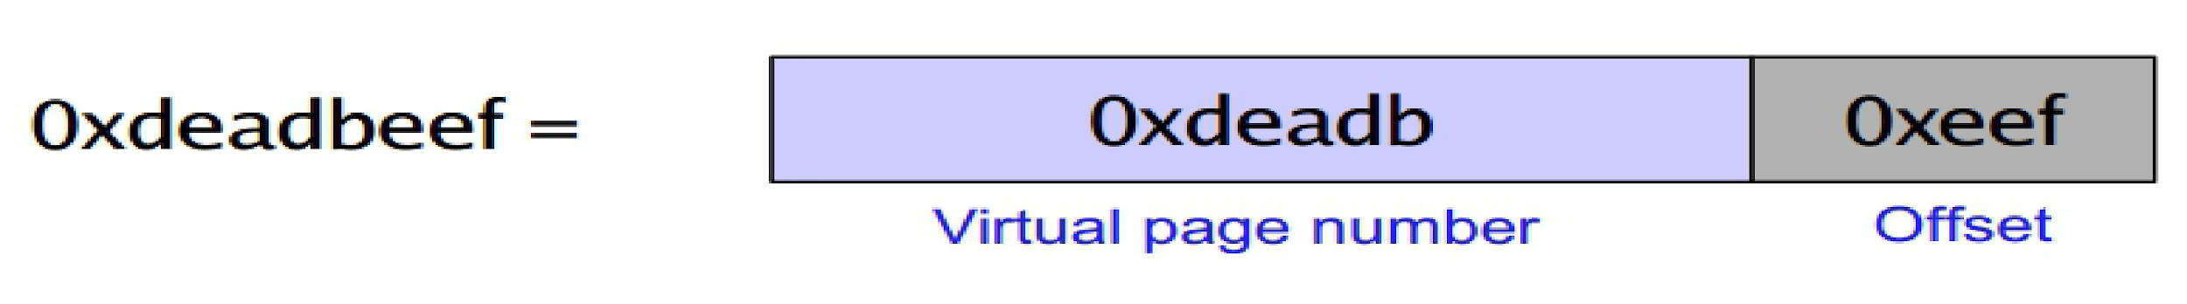
Paging: Address Translation (1)
Translation is done by MMU
Virtual address is broken into
Virtual page number
Virtual page offset
Example
With a 32bit address and a 4kB page size, the upper 20 bits could specify one of the 1M virtual pages and the lower 12 bits would then specify the byte offset (0 to 4095) within the selected page
Chunk’s
Addresses

Slide 14
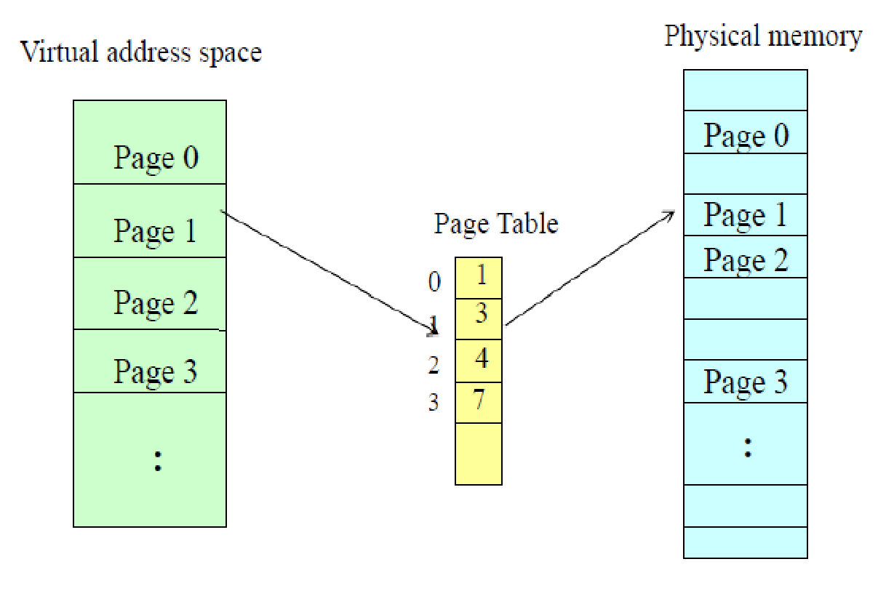
Paging: Address Translation (2)
Translation is done by MMU
Virtual address is broken into
Virtual page number
Virtual page offset
0x0000
0x1000
0x2000
0x3000
0x0000
0x1000
0x2000
0x3000
0x4000
0x5000
0x6000
0x7000
Virtual page number is used to get page frame number
Mapping function
Implemented with page table
Virtual page offset is kept the same
(see next slide)
pages
page
frames

Slide 15
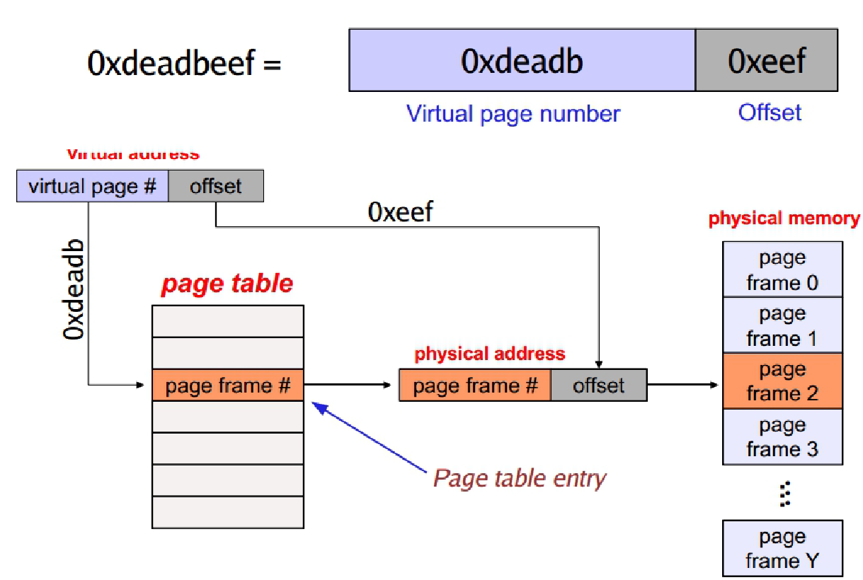
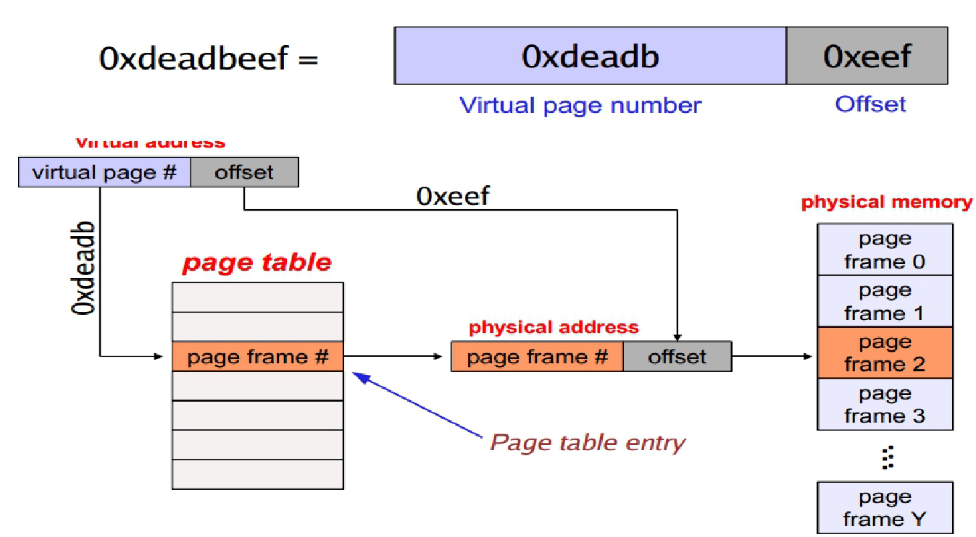
Paging: Address Translation (3)
virtual address
…
0x2eef
…
page table

Slide 16
Page Table
Each page table entry includes a page frame number (if any)
Number of entries in page table = virtual address space size/page size
Located in main memory
One page table per process

Slide 17
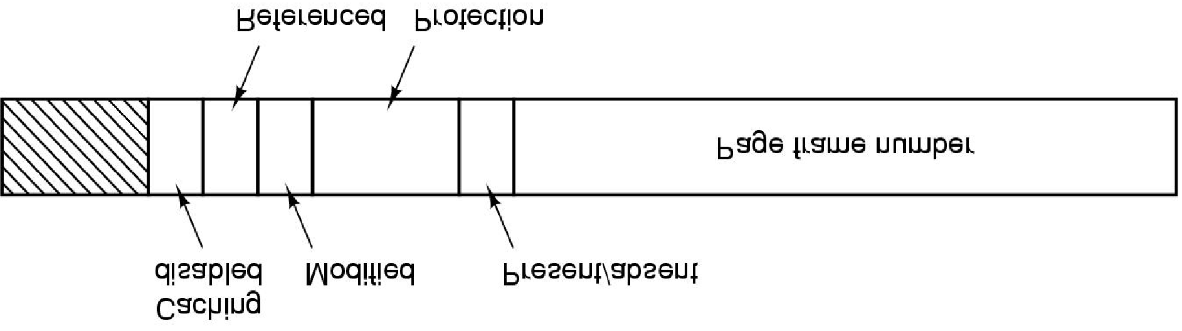

Page Table Entry
Modified, Referenced bits
Keep track of page usage, flagged by the hardware
Protection bit
What kind of access is permitted (read, write, execute)
Present/absent (valid/invalid) bit
1, entry is valid and can be used
0, page is not currently in memory
Accessing a page with absent/invalid entry causes a page fault
Notes:
The exact layout of an entry in the page table is highly
machine dependent, but the kind of information present is roughly the same from
machine to machine. The Protection bits tell what kinds of access are permitted. In the simplest
form, this field contains 1 bit, with 0 for read/write and 1 for read only. A more
sophisticated arrangement is having 3 bits, one bit each for enabling reading, writing,
and executing the page.
The Modified and Referenced bits keep track of page usage. When a page is
written to, the hardware automatically sets the Modified bit. This bit is of value
when the operating system decides to reclaim a page frame. If the page in it has
been modified (i.e., is ‘‘dirty’’), it must be written back to the disk. If it has not
been modified (i.e., is ‘‘clean’’), it can just be abandoned, since the disk copy is
still valid. The bit is sometimes called the dirty bit, since it reflects the page’s
state.
The Referenced bit is set whenever a page is referenced, either for reading or
for writing. Its value is used to help the operating system choose a page to evict
when a page fault occurs. Pages that are not being used are far better candidates
than pages that are, and this bit plays an important role in several of the page replacement
algorithms that we will study later in this chapter.
Finally, the last bit allows caching to be disabled for the page. This feature is
important for pages that map onto device registers rather than memory. If the operating
system is sitting in a tight loop waiting for some I/O device to respond to a
command it was just given, it is essential that the hardware keep fetching the word
from the device, and not use an old cached copy. With this bit, caching can be
turned off. Machines that have a separate I/O space and do not use memory-mapped
I/O do not need this bit.

Slide 18
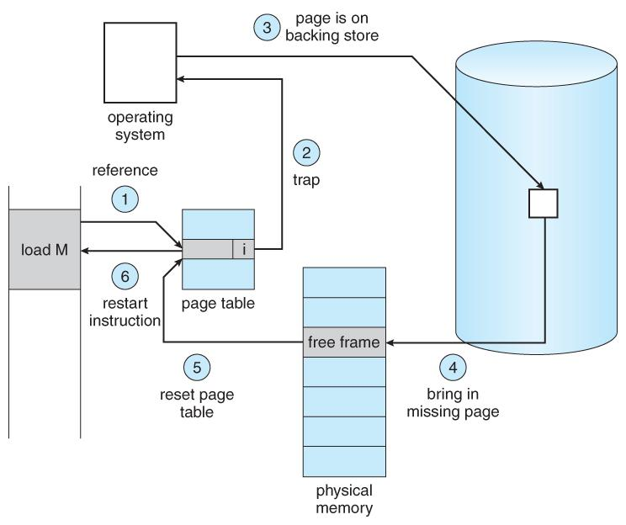
Page Fault
storage
process
Abraham Silberschatz, Greg Gagne, and Peter Baer Galvin, "Operating System Concepts, Ninth Edition ", Chapter 9

Slide 19
Paging: Summary
OS loads into MMU a page table per process
Every time process generates a virtual address
MMU uses the virtual page number bits to lookup the page table for corresponding page frame number
If a page table entry is found
The MMU uses that page frame number and the offset bits to generate the memory request
If a page table entry is not found
A page fault is generated
The OS will load the page (from disk), add the mapping to the page table
The OS will resume process execution

Slide 20
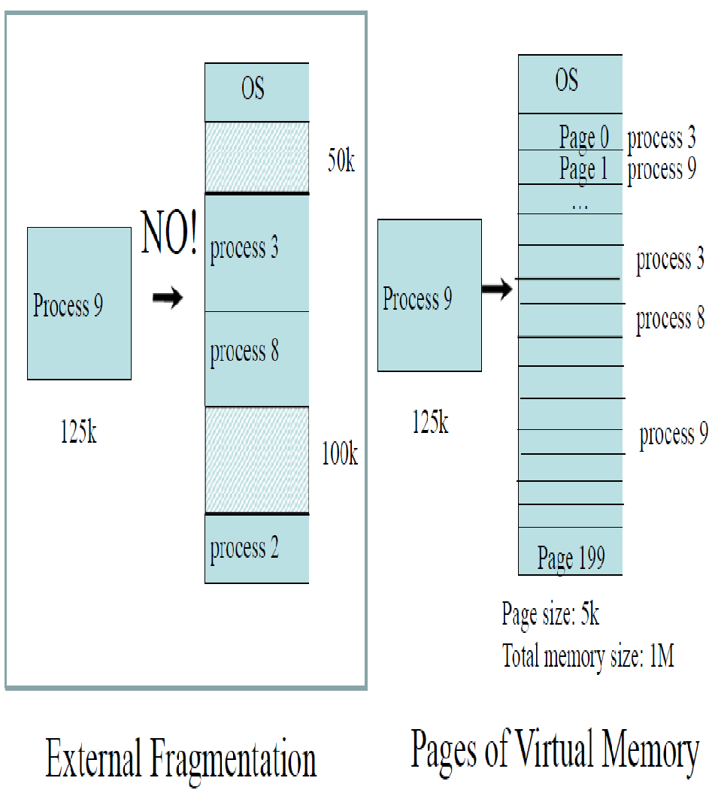
How Do Pages Fix External Fragmentation Problem?

Slide 21
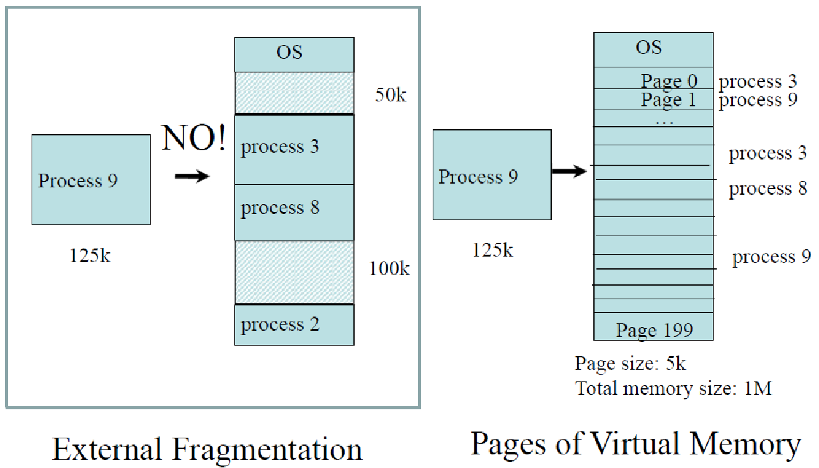
How Do Pages Fix External Fragmentation Problem?

Slide 22
Some Facts
A n-bit virtual address space
The virtual address consists of n bits
There are 2^{n} virtual addresses
A n-bit virtual address space with k bits for offset
Each page consists of 2^{k} virtual addresses
The virtual page number takes (n-k) bits
There are 2^{(n-k)} virtual pages
There are 2^{(n-k)} entries in the page table
A m-bit physical address space
The physical address consists of m bits
There are 2^{m} physical addresses
A m-bit physical address space with k bits for offset
Each page frame consists of 2^{k} physical addresses
The page frame number takes (m-k) bits
There are 2^{(m-k)} physical pages

Slide 23
Exercise 1: Page Table Size
Consider a 32-bit virtual address space. Each page consists of 4096 virtual addresses. Assume each page table entry (PTE) takes 4 bytes
Questions
What is the size of the page table for one process?
What is the total size of the page tables for 100 running processes?
Answers
Page table entries: 2^(32-12)=2^20. Size of table = 4*2^20 Bytes = 4MB
100*4 = 400MB

Slide 24
Improving Paging

Slide 25
Improving Paging
The mapping from virtual address to physical address must be fast
Translation Lookaside Buffer (TLB)
The page table size should be proportional to the used portion of address space
Multi level page table

Slide 26
Translation Lookaside Buffer (1)
Virtual to physical mapping must be done on every memory reference
One, two, or three page table reference per instruction
Example
If a page table reference in RAM takes 1nsec, an instruction that requires 3 references requires additionally 3nsec, total 6
Note, without paging you need 3nsec

Slide 27
Translation Lookaside Buffer (2)
Solution
Reduce accesses by caching recent mappings in translation lookaside buffer (TLB)
Why does it work?
Because most programs often make a large number of references to a small number of pages

Slide 28
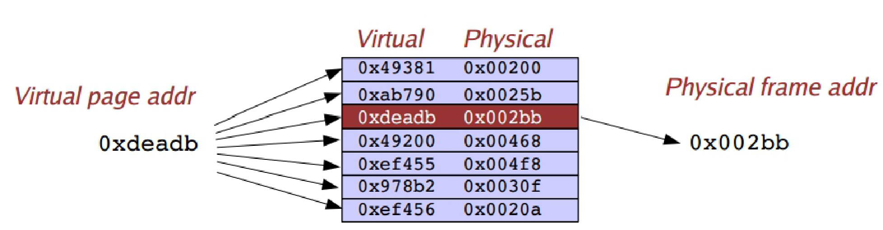
Translation Lookaside Buffer (2)
Translation Lookaside Buffer or TLB
Maps virtual addresses to physical addresses without going through the page table
Sometimes an associative memory or cache
Caches most recent virtual to physical address translations
TLB

Slide 29
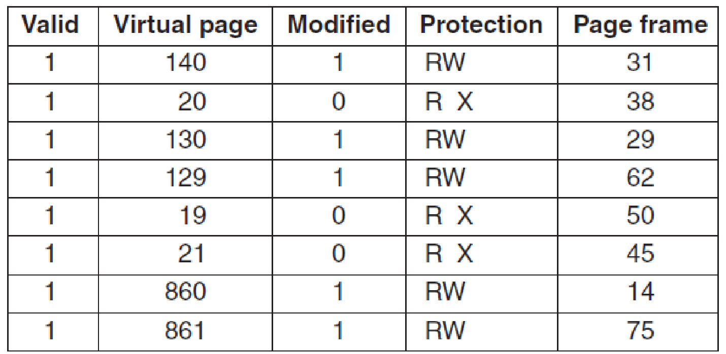
Translation Lookaside Buffer (3)
Translation Lookaside Buffer or TLB
A more realistic example
Figure 3-12. A TLB to speed up paging.

Slide 30
Translation Lookaside Buffer (4)
CPU sends virtual addresses to the MMU
Translation Lookaside Buffer
MMU sends physical addresses to the memory
Notes:
On computers without virtual memory, the virtual address is put directly onto the memory bus and causes the physical memory word with the
same address to be read or written. When virtual memory is used, the virtual addresses
do not go directly to the memory bus. Instead, they go to an MMU (Memory
Management Unit) that maps the virtual addresses onto the physical memory
addresses, as illustrated in Fig. 3-8.

Slide 31
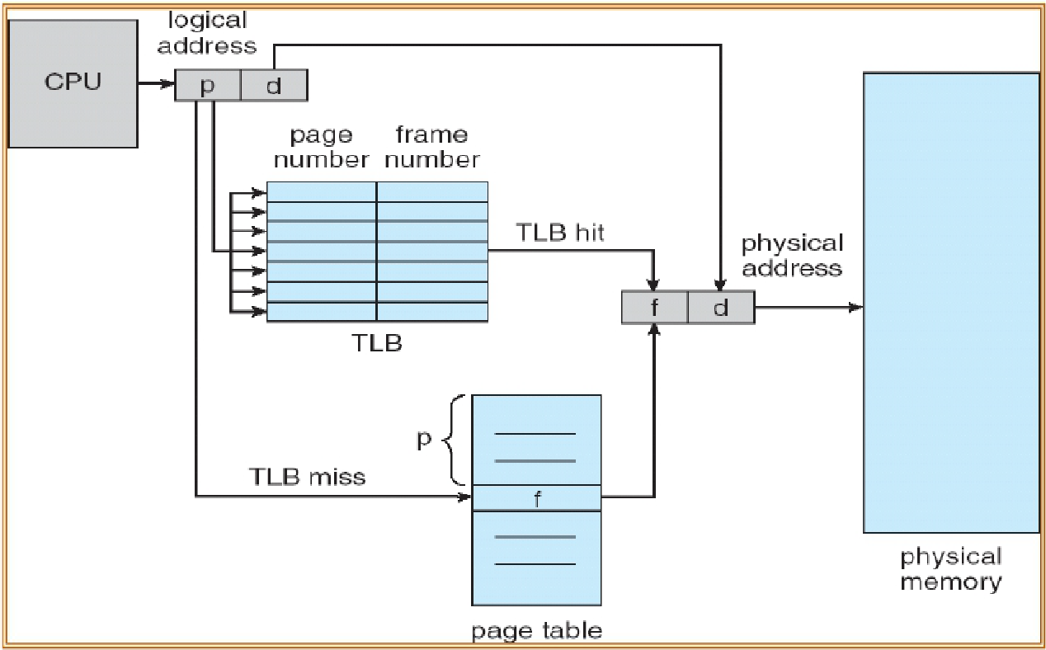
Translation Lookaside Buffer (5)

Slide 32
How Long Do Memory Accesses Take?
Assume the following times:
TLB lookup time = a (often zero - overlapped in CPU)
Memory access time = m
Hit ratio (h) is percentage of time that a logical page number is found in the TLB
Larger TLB usually means higher h
TLB structure can affect h as well
What is the effective access time (EAT)?
EAT = (m + a)h + (m + m + a)(1-h) =a + (2-h)m

Slide 33
Multilevel Page Tables (1)
High memory overhead with described page table
If the virtual address space is large
The page table will be large
If the program uses a small fraction of the address space
The entire page table is needed
Example
A 31bit address space for application (2GB)
4kB pages, 4bytes per page entry
2MB page table
100 programs running 200MB (10%)

Slide 34
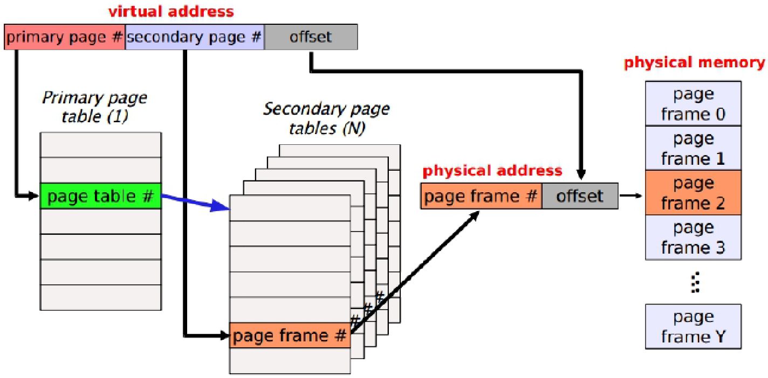
Multilevel Page Tables (2)
Basic idea is to “page” the page tables
Divide virtual address into multiple portions
high page bits, low page bits, offset bits

Slide 35
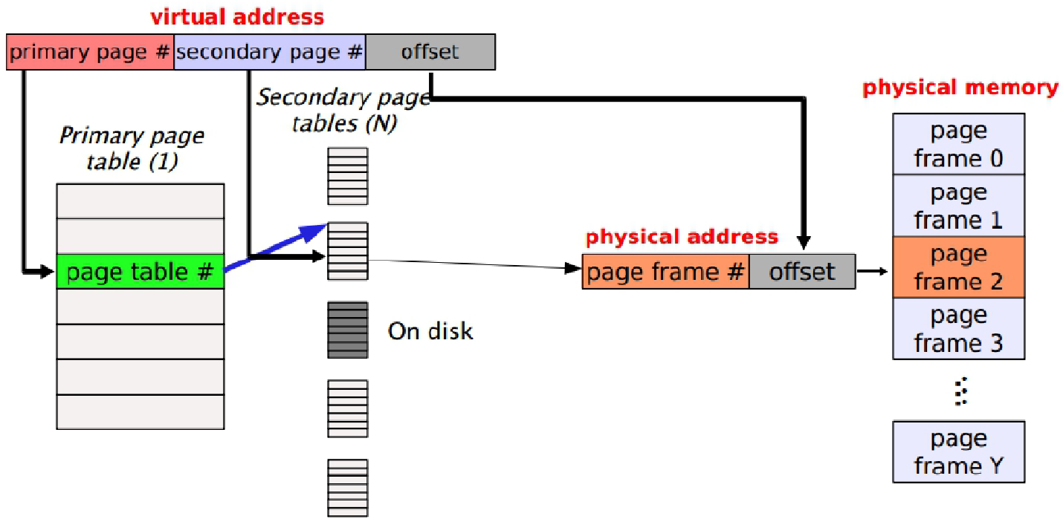
Multilevel Page Tables (3)
Allow portions of the page tables to
Be kept in memory at one time
Do not be present at all

Slide 36
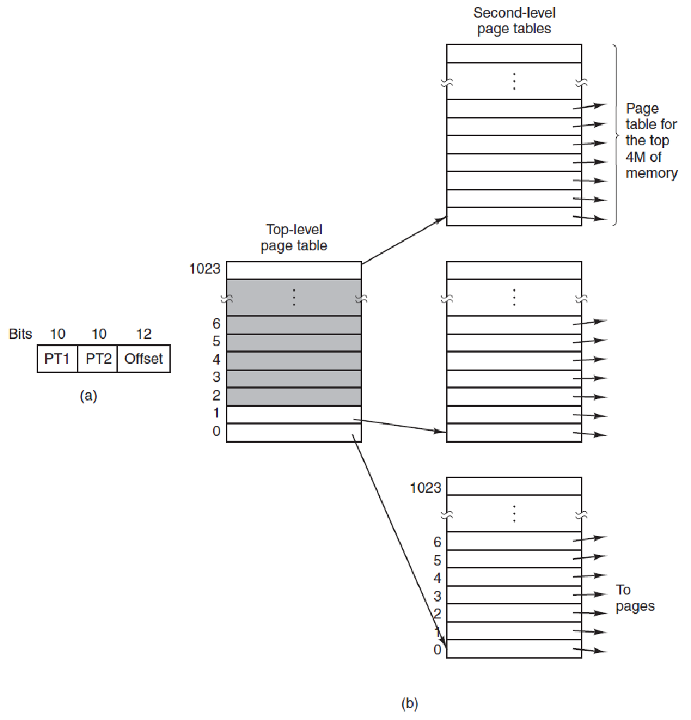
Multilevel Page Tables (4)
(a) A 32-bit address with two page table fields. (b) Two-level page tables. (MOS Figure 3-1)
Example
A 32bit address space (4GB)
4kB pages, 4bytes per page entry
Application occupies 12MB space
16kB page table (vs 4MB linear table)

Slide 37
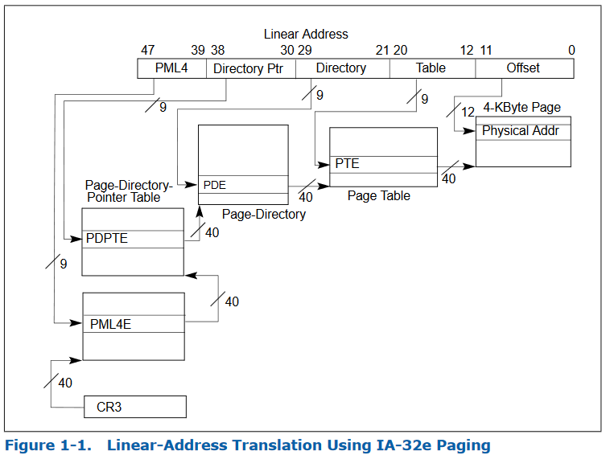
Multilevel Page Tables (5)
Multi-level page tables can be extended to N levels as the address space gets larger
x86_64 supports up to 4 levels
https://software.intel.com/sites/default/files/managed/2b/80/5-level_paging_white_paper.pdf
Notes:
https://software.intel.com/sites/default/files/managed/2b/80/5-level_paging_white_paper.pdf
IA-32e mode comprises two sub-modes: compatibility mode and 64-bit mode. In compatibility mode, software uses 32-bit addresses, which the processor zero-extends to 64-bit linear addresses. In 64-bit mode, software uses 64-bit addresses directly

Slide 38
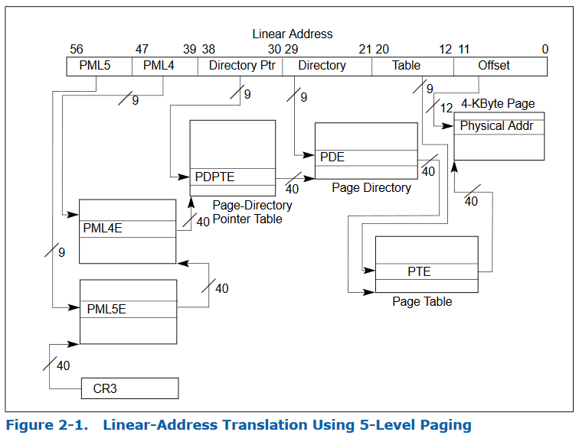
Multilevel Page Tables (6)
5-levels!!!
https://software.intel.com/sites/default/files/managed/2b/80/5-level_paging_white_paper.pdf

Slide 39
How Big Is a Multilevel Page Table? (1)
Consider a 32-bit virtual address space. Each page consists of 4K virtual addresses. Also assume each page table entry (PTE) takes 4 bytes.
Recall: A 1-level page table takes 4MB!
Question: assume the 32-bit address is allocated as following: 10 bits to the primary page, 10 bits to the secondary page, 12 bits to the page offset
What is the size of each 2-level page table?
What is the total size of the page tables (including 1-level and 2-level ones)?
How much memory is needed for one virtual address translation?
• -2^10*4=4KB
• -1025*4KB = 4MB and 4 KB
• - 8 KB

Slide 40
How Big Is a Multilevel Page Table? (2)
Consider a 32-bit virtual address space. Each page consists of 4K virtual addresses. Also assume each page table entry (PTE) takes 4 bytes.
Recall: A 1-level page table takes 4MB!
Question: assume the 32-bit address is allocated as following: 5 bits to the primary page, 15 bits to the secondary page, 12 bits to the page offset.
What is the size of each 2-level page table?
What is the total size of the page tables (including 1-level and 2-level ones)?
How much memory is needed for one virtual address translation?
• -L1: 128B (2^5=32) L2: 128KB (2^15=32k)
• -128B + 32*128KB = 4MB+128B
• -128KB + 128B = 128.125KB

Slide 41
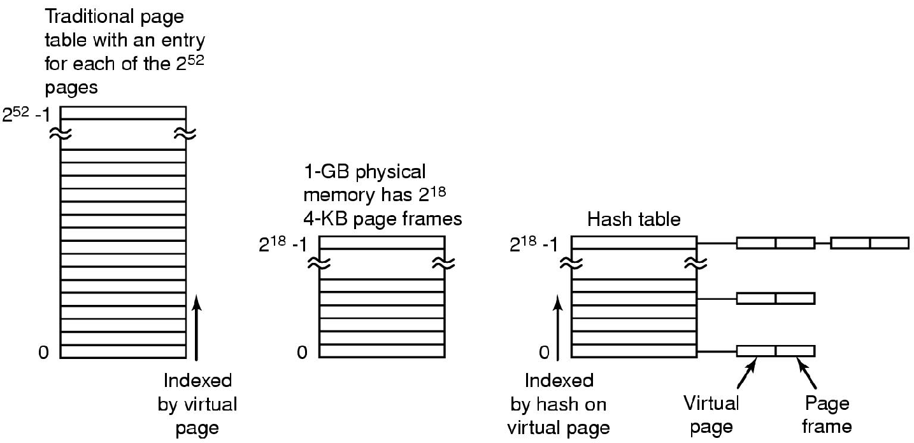
Other approaches?
Inverted page table (hashed maps)
For every physical page save the list of virtual
Long to search
Instead hash virtual addresses to buckets
Comparison of a traditional page table with an inverted page table. (MOS Figure 3-14)
Notes:
In this design, there is one entry per page frame in real memory, rather than one entry per page of virtual address space
with 64-bit virtual addresses, a 4-KB page size, and 4 GB of RAM, an
inverted page table requires only 1,048,576 entries. The entry keeps track of which (process, virtual page) is located in the page frame
virtual-to-physical translation becomes much harder ->make use of the TLB
One feasible way to accomplish this search is to have a hash table hashed
on the virtual address. All the virtual pages currently in memory that have the same
hash value are chained together, as shown in Fig. 3-14. If the hash table has as
many slots as the machine has physical pages, the average chain will be only one
entry long, greatly speeding up the mapping. Once the page frame number has
been found, the new (virtual, physical) pair is entered into the TLB.

Slide 42
Other approaches?
Inverted page table (hashed maps)
For every physical page save the list of virtual
Long to search
Instead hash virtual addresses to buckets
Comparison of a traditional page table with an inverted page table. (MOS Figure 3-14)
Notes:
In this design, there is one entry per page frame in real memory, rather than one entry per page of virtual address space
with 64-bit virtual addresses, a 4-KB page size, and 4 GB of RAM, an
inverted page table requires only 1,048,576 entries. The entry keeps track of which (process, virtual page) is located in the page frame
virtual-to-physical translation becomes much harder ->make use of the TLB
One feasible way to accomplish this search is to have a hash table hashed
on the virtual address. All the virtual pages currently in memory that have the same
hash value are chained together, as shown in Fig. 3-14. If the hash table has as
many slots as the machine has physical pages, the average chain will be only one
entry long, greatly speeding up the mapping. Once the page frame number has
been found, the new (virtual, physical) pair is entered into the TLB.

